Slide 1
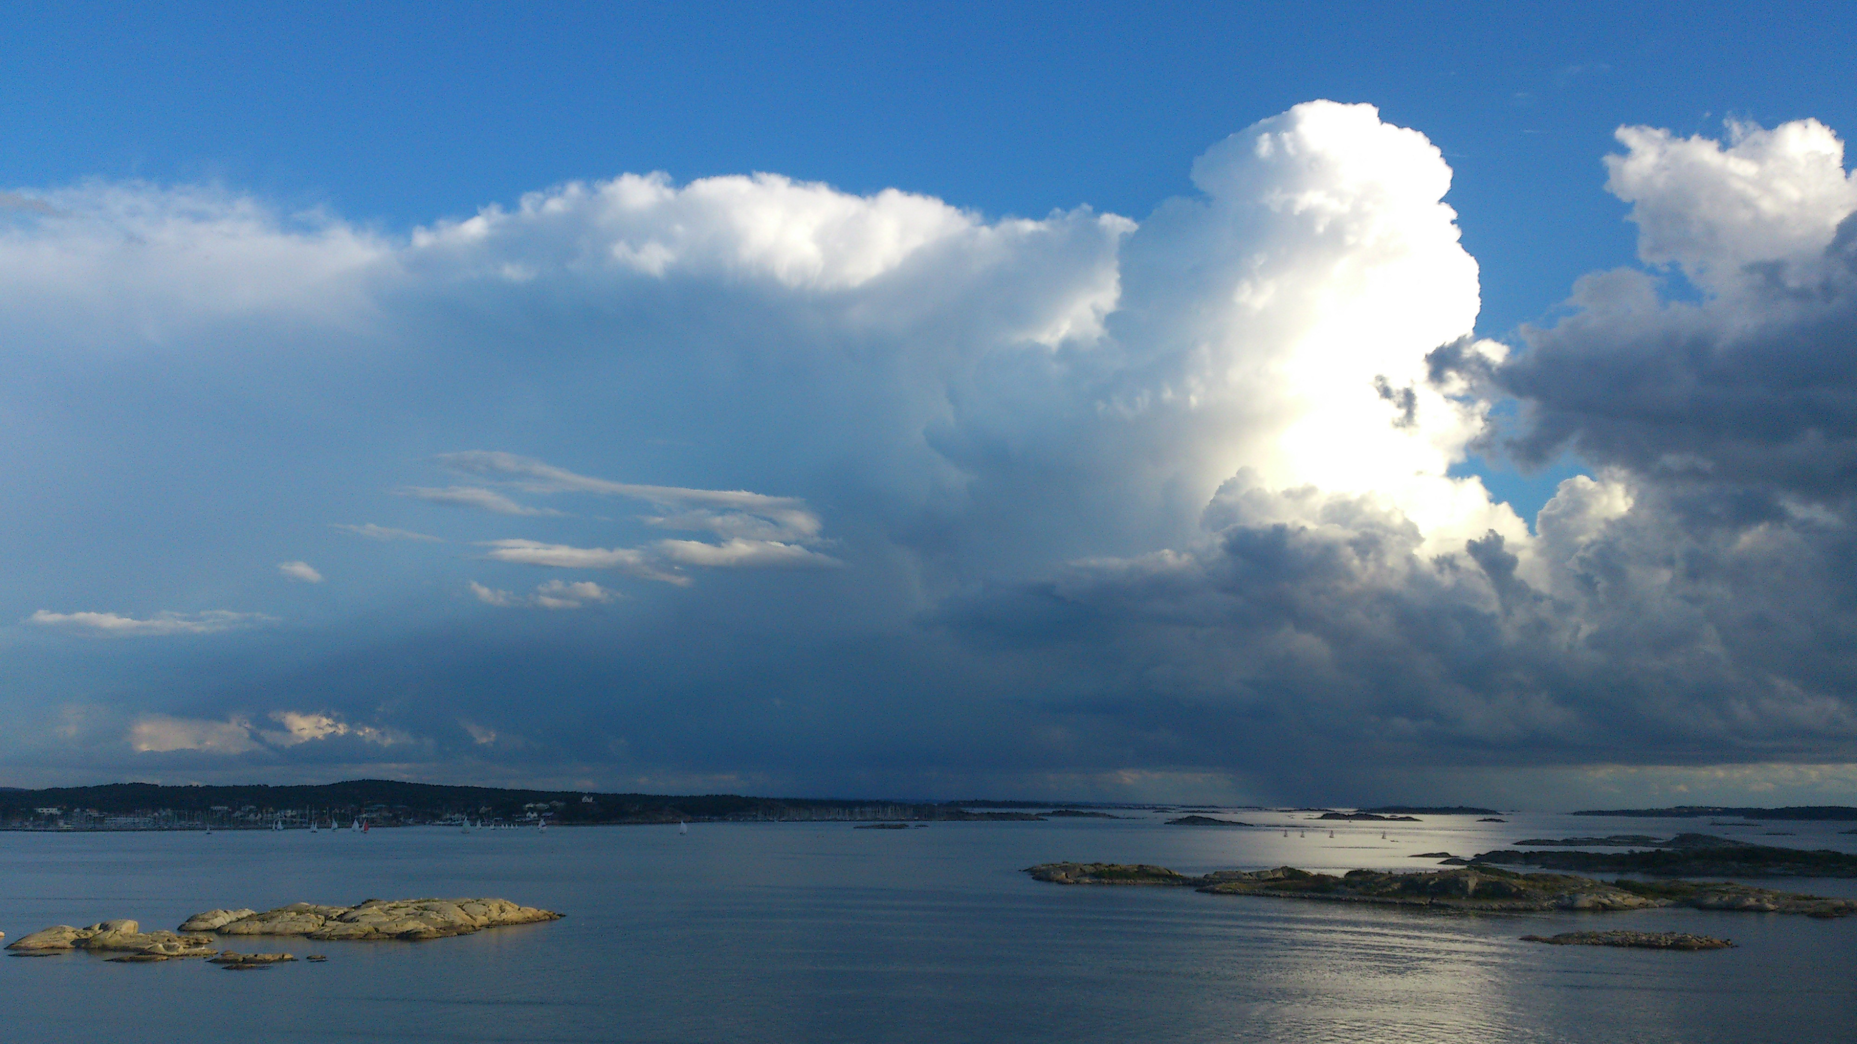
Cloud: parcel? Model?
By Chenxi Qiu & Edward Groot

Slide 2
Aim
Relevance of some processes for convective cloud:
Entrainment
Phase of cloud (liquid/ice/mixed)
Environment

Slide 3
Mixing
Model: dynamic equations – sources/sinks
W
Mixing
Cloud content
Buoyancy
Mixing
Evaporation
θ
Melting
Condensation
Freezing (&ice deposition)
Parcel mass

Slide 4
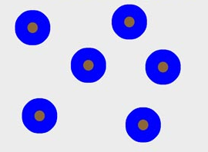
Model: moisture & cloud processes
VAPOR
E
<100% RH
C
100% RH
D
First step
Second step
Third step

Slide 5
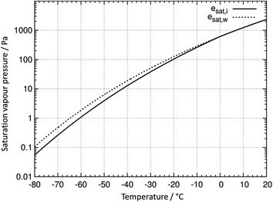

Model: moisture & cloud processes
VAPOR
E
<100% RH
C
100% RH
Parameterization based on Rotstayn et al. (2000), between 0 and -38°C
M
0 °C
D
F
-38 °C
First step
Second step
Third step

Slide 6

Model: moisture & cloud processes
VAPOR
E
<100% RH
C
100% RH
Parameterization based on Rotstayn et al. (2000), between 0 and -38°C
Slow
WL > WL.thres
Leaves parcel
M
0 °C
D
F
-38 °C
Fast
WI > WI.thres
First step
Second step
Third step

Slide 7
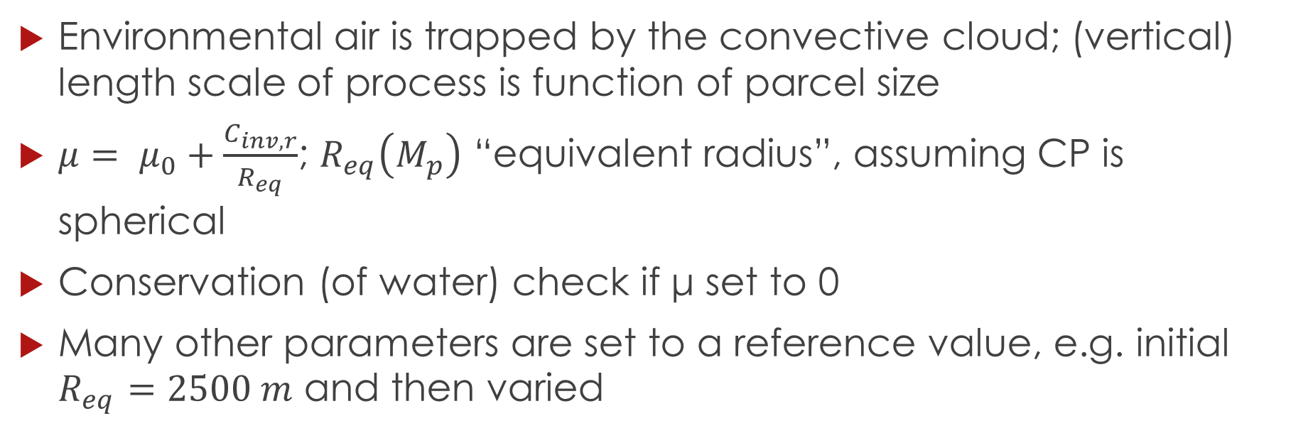
Dynamic entrainment
Environmental air is trapped by the convective cloud; (vertical) length scale of process is function of parcel size
$μ= μ_{0}+\frac{C_{inv,r}}{R_{eq}}$; $R_{eq}\left(M_{p}\right)$ “equivalent radius”, assuming CP is spherical
Conservation (of water) check if μ set to 0
Many other parameters are set to a reference value, e.g. initial $R_{eq}=2500 m$ and then varied

Slide 8
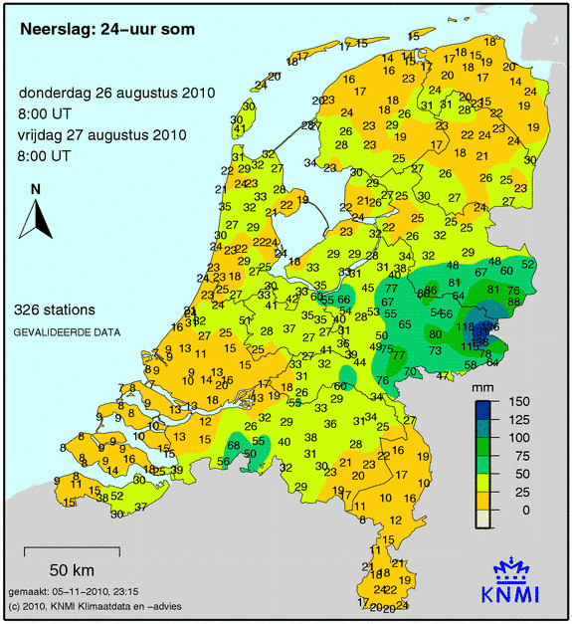
Environmental profile + assumptions
Convective rain event in Gelderland & Overijssel
Observations of August 26th 2010 12 UTC/GMT in Essen, Germany
Slightly modified, assuming enriched moisture at ±3 km
Classical “surface based” convection
Initial small disturbance T & water vapor
Linear interpolations between nearest levels

Slide 9
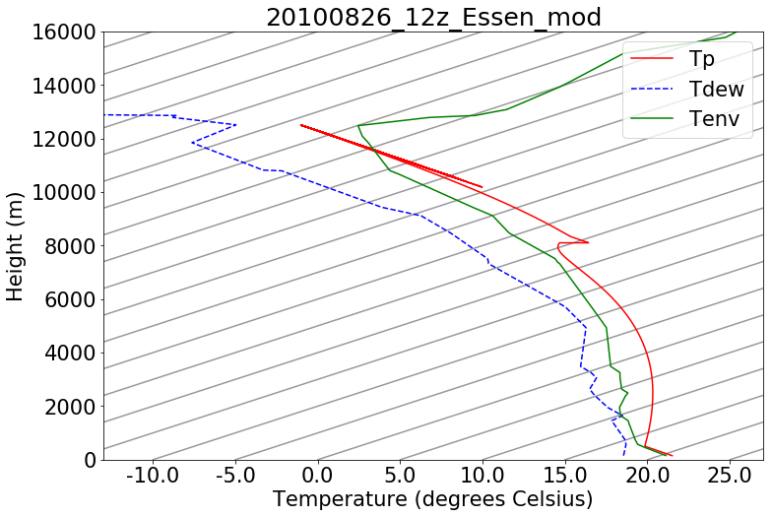
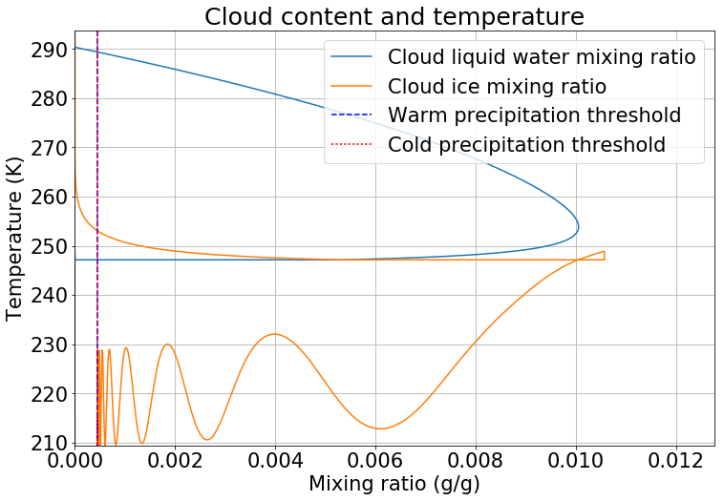
No entrainment
time
Heat of fusion
isotherms
Z (m)
time
0 °C
Mean precipitation over the final area of the parcel: 4.40 mm

Slide 10
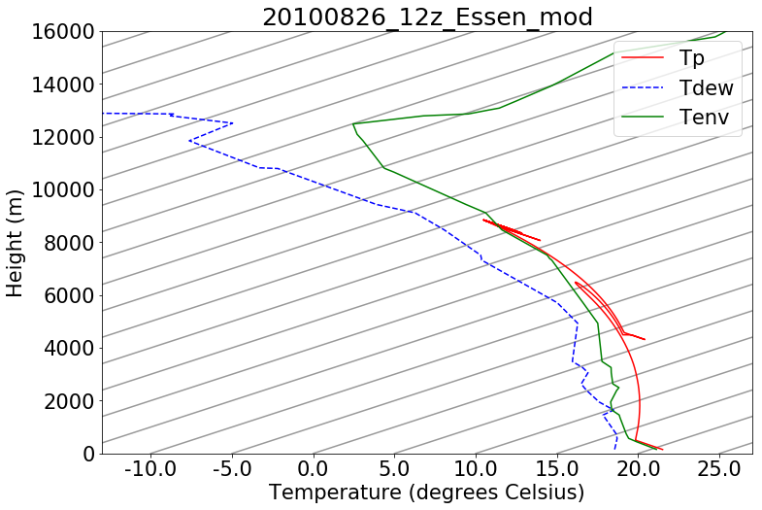
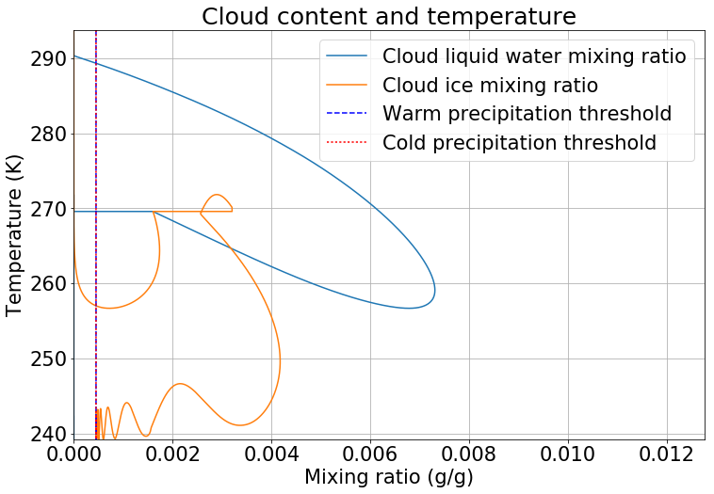

Constant entrainment $μ_{0}=5×{10}^{−5}$
time
isotherms
Z (m)
time
0 °C
Mean precipitation over the final area of the parcel: 3.97 mm

Slide 11
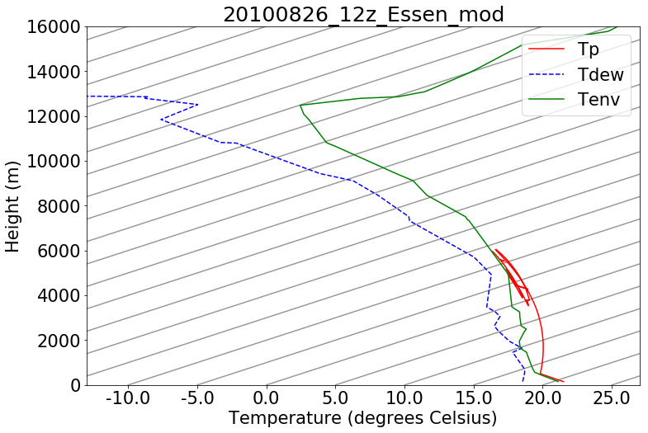
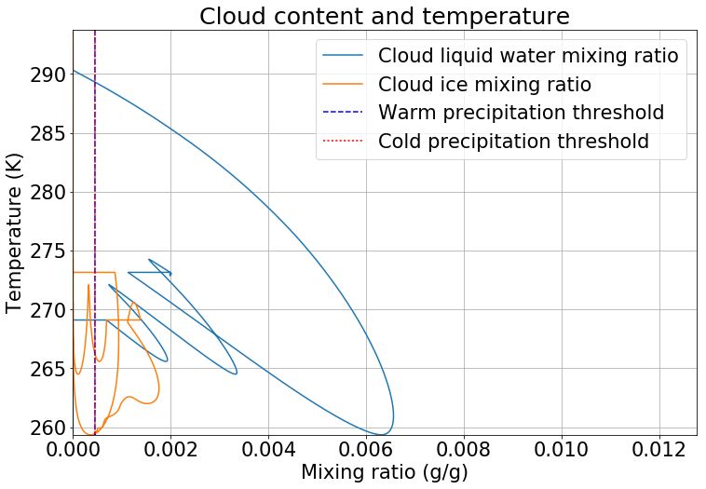

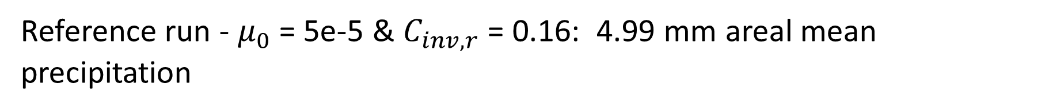
Full entrainment $μ= μ_{0}+\frac{C_{inv,r}}{R_{eq}}$
time
Reference run - $μ_{0}$ = 5e-5 & $C_{inv,r}$ = 0.16: 4.99 mm areal mean precipitation

Slide 12
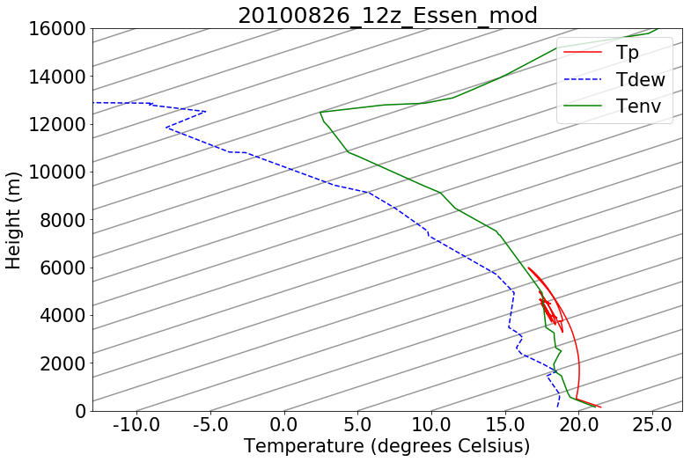
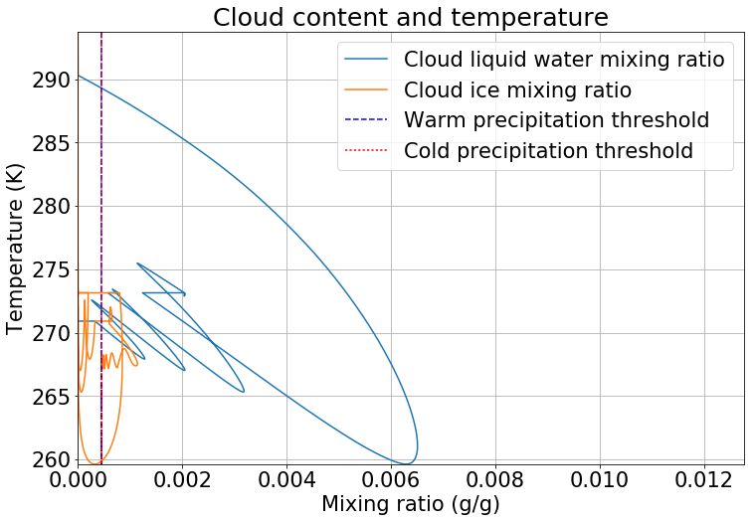
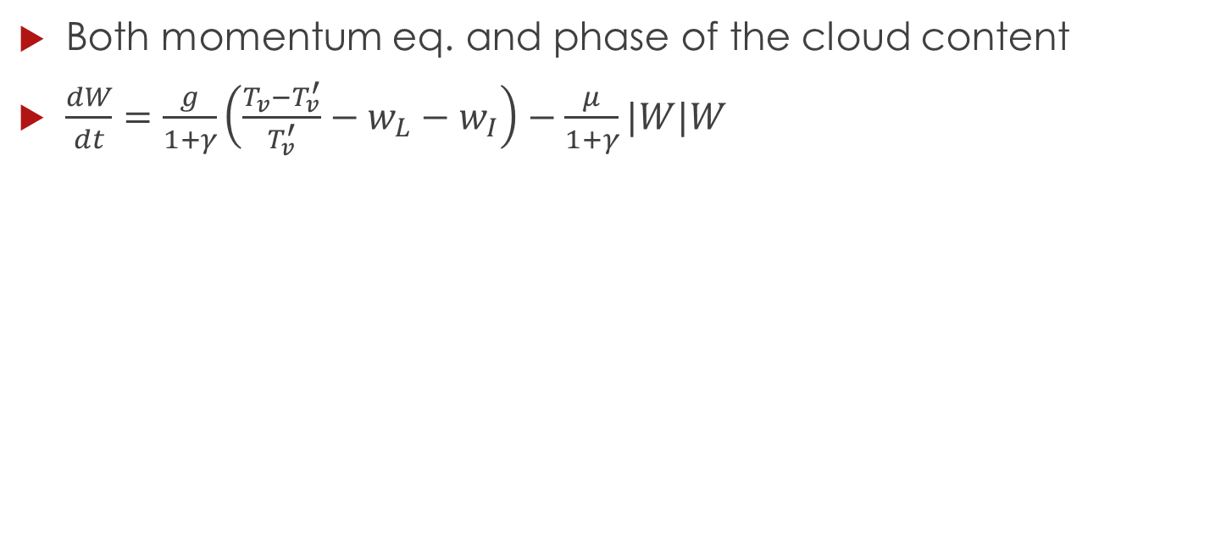
Sensitive
Both momentum eq. and phase of the cloud content
$\frac{dW}{dt}=\frac{g}{1+γ}\left(\frac{T_{v}−T_{v}^{′}}{T_{v}^{′}}−w_{L}−w_{I}\right)−\frac{μ}{1+γ}|W|W$
Tmelt

Slide 13
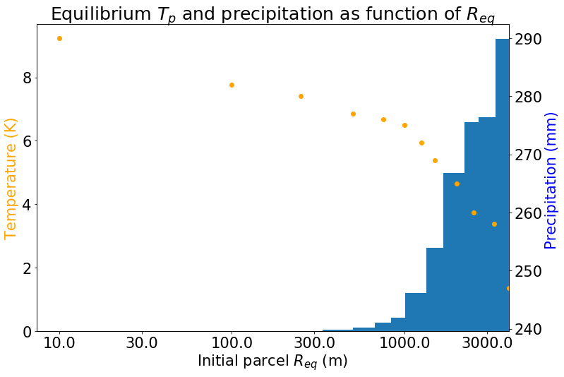
Change initial Req
Reference value: reasonable values 300-5000 m
But this cloud has relevance for environmental moisture at z = 2.5-3 km

Slide 14
Sensitivity upper air moisture
Reduction of moisture above z = 2 km
Reduction | Mean precipitation (mm) | Cloud equilibrium temperature (K)
0% | 4.99 | 260
2% | 4.02 | 264
4% | 2.50 | 267
25% | 0.34 | 277

Slide 15
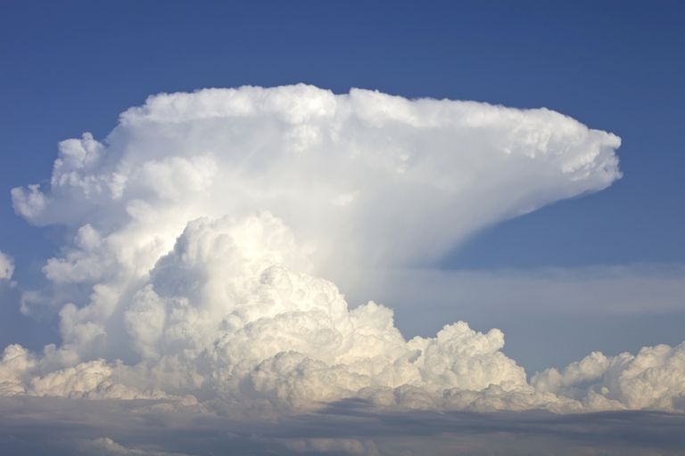
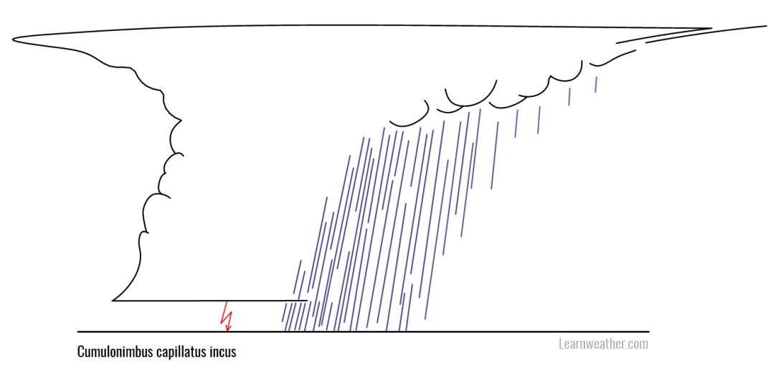
Discussion
Horizontal dynamics excluded in parcel model, but essential as “sorting mechanism”

Slide 16
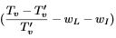
Discussion
No oscillatory behavior in reality (either dissipation or persistance)
In this model, condensed water or ice gets either inside or outside parcel
Interaction parcel & cloud content
Limitation of parcel model
In general the parameterizations (foremost conversion to ice) are hugely simplified
No sublimation/riming (all via liquid water)

Slide 17
Conclusions
The parcel model allows to illustrate some senstivity for entrainment & phases
Relevance feedbacks: e.g. release of heat of fusion
However, the most important limitations:
no horizontal wind field
In reality, convective clouds may co-exist and interact

Slide 18
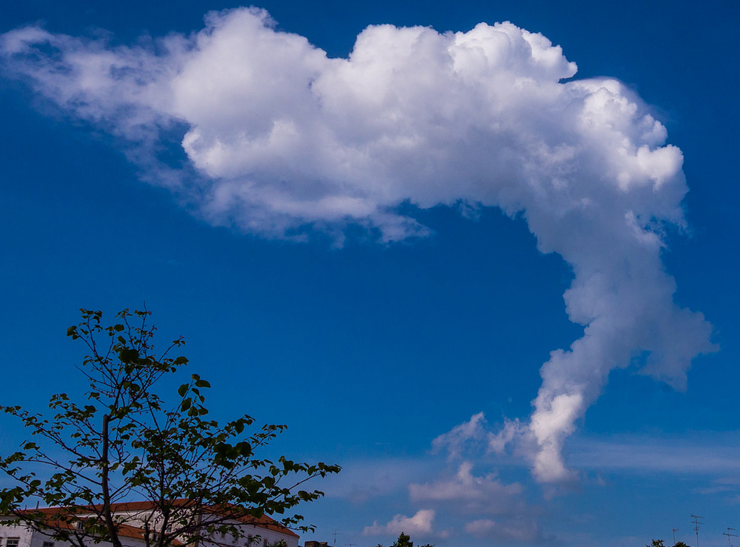
Thank you for your attention

